Slide 1
Middle School Week Four
Notes:
Comic Book: https://www.orangefrogschools.com/middle-school/ofcomicbook
Video: https://vimeo.com/522428426

Slide 2
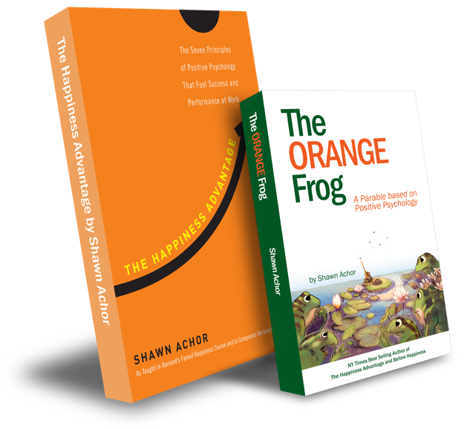
The Happiness Advantage
and
The Orange Frog
By Shawn Achor

Slide 3
The Orange Frog
Learning Objective:
I can think and act like Spark.
I will discuss what it means to handle situations like Spark.
Notes:
Standard:
Essential Concept and/or Skill: Communicate and work productively with others emphasizing collaboration and cultural awareness to produce quality work.
Interact positively as a team member.
Cooperate with others in a group setting.
Generate ideas with group members.
Are active listeners.
Read and understand information in a variety of forms.
Express ideas.
Skill:
Active listening, express ideas
Allow Spark to read pages 13-18 for the students or read to them.
https://www.orangefrogschools.com/elementary/ofkidsbook

Slide 4
Skills
Interact positively as a team member.
Cooperate with others in a group setting.
Generate ideas with group members.
Are active listeners.
Read and understand information in a variety of forms.
Express ideas.

Slide 5
A Word From Shawn

Slide 6
Thoughts
The comic begins by reminding us that just because we’re Orange doesn’t mean we don’t see the problems. It simply means that we know that we can do something about them. The frogs devise a plan to work smarter, not harder, with the Deluge coming. Once again, Misty reminds us that helping others is one of the quickest ways to become Orange. Even Plop learns that he, too, can become Orange. With a lot of teamwork, courageous positivity, and inclusion, the frogs come together to rebuild what the Deluge destroys.

Slide 7
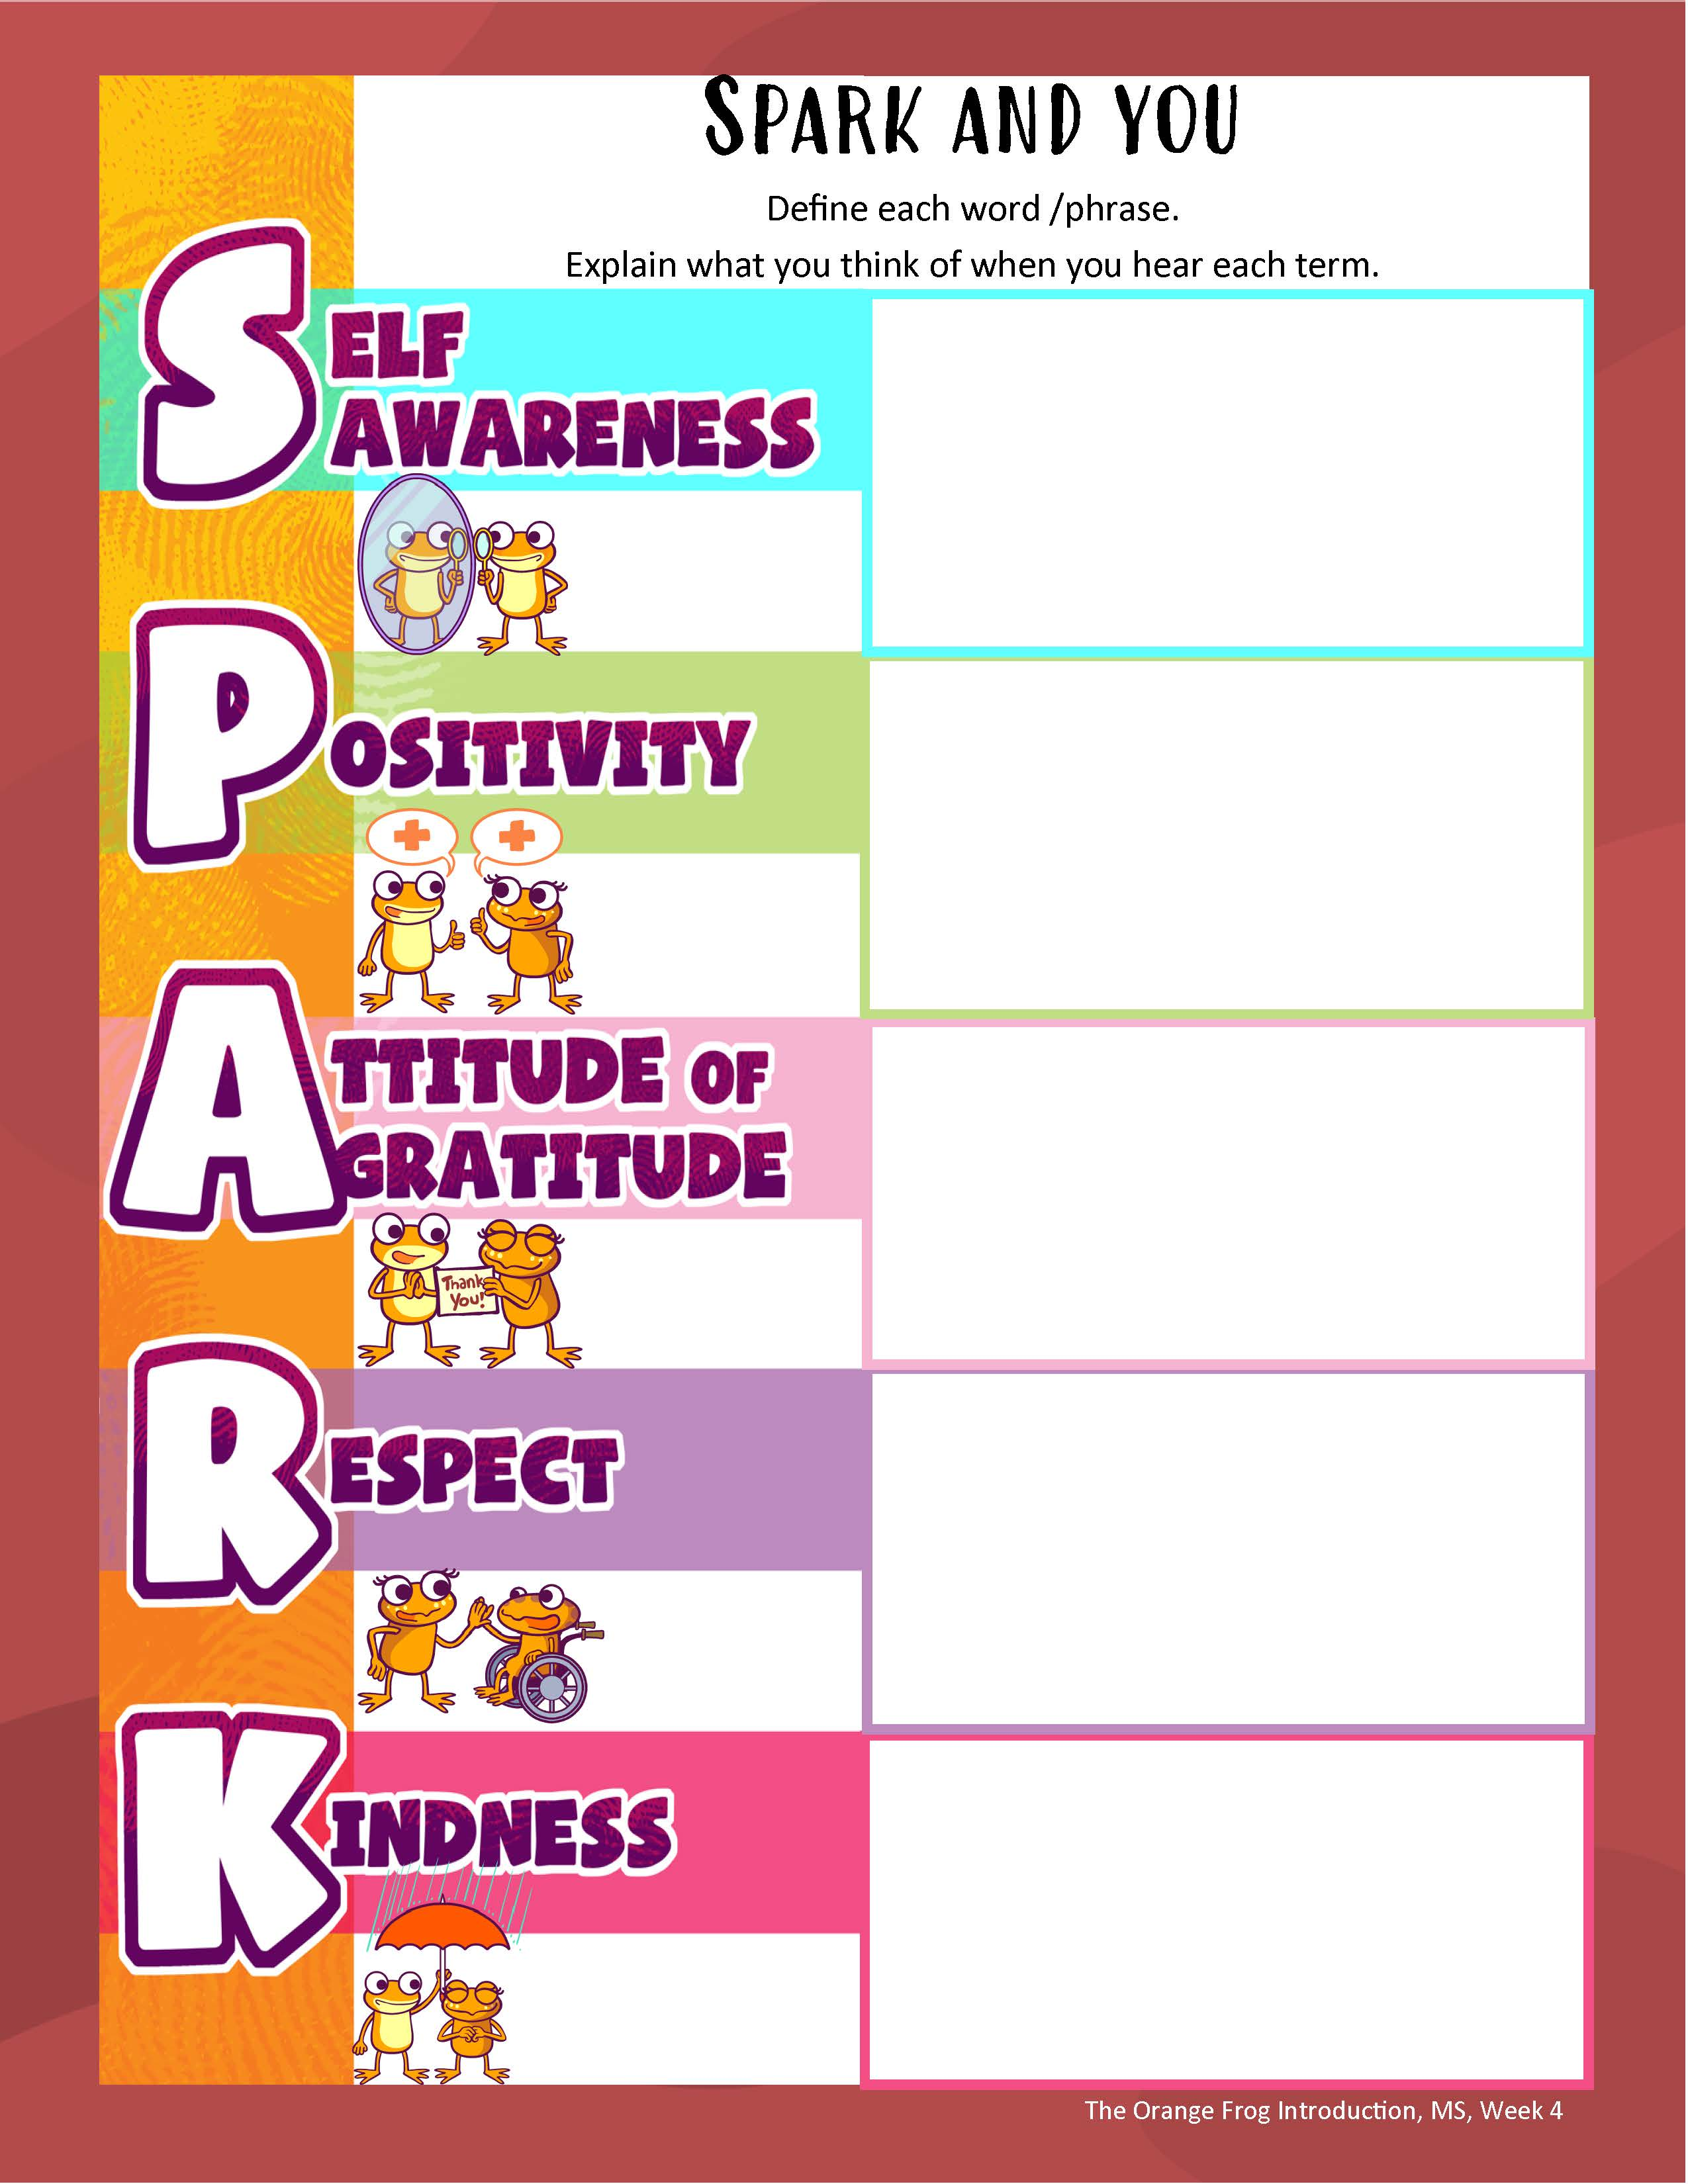
Action
We know the number one catalyst in the Orange Movement on the Island is Spark. Spark is responsible for the work that gets started and continues long after the Deluge. Let’s look at an acronym for SPARK.
First, let’s define each word/phrase. I want to make sure that everyone fully understands each concept. We talk so much about Self-Awareness here. It’s centers around knowing yourself. Tell me what you think of when you hear:
Notes:
You can either use this as a group activity and share on a projector or print out copies provided on the website for students to cut and paste the pictures on their own.
Click the SPARK Acronym worksheet image above to be linked to a PDF for the students.

Slide 8
Bonus Questions
Where is the first place Plop develops a spot?
What is one of the things Misty did to promote Orange?
Were the frogs done building when the Deluge hit?
What kind of business did Bull build?

